Slide 1


OKCUPID.COM Data Mining Case I Ohm Kundurthy
Notes:
I am Ohm Kundurthy and I ll present Data Mining Case 1 for OK Cupid's Marketing use

Slide 2
agenda
Problem Statement
Data Summary
Identification of Personas
Visualizations & Profile Insights
Takeaways for Marketing Strategy
Notes:
agenda is simple - first we define the problem statement ; review data available ; talk about personas identified ; then we ll look at some data visualizations and finally talk through takeaways for marketing head

Slide 3
Problem Definition
OKCUPID’s Business Intelligence team is tasked with review of user profile data to identify and present actionable insights to head of marketing to help
Expansion of user base
User Retention
Identify opportunities for targeted marketing
Drive Revenue Growth
Notes:
problem definition is a data mining excercise to review user profiles and create some insights that head of marketing can use to increase user base , and identify other revenue opportunities

Slide 4
Understanding Profile Data
Several data files were provided to the BI team as part of the data mining project.
Profiles is the most important file (anonymized) user profile details .
latlon is a useful file to get the geographical information necessary to present profile info on a map.
Notes:
a few files were shared, most notable is profiles.csv that has most info on user profiles and then also latlon helped to plot locations on a map for user interactive maps

Slide 5
DATA SUMMARY#1
Character Attributes
# | Variable | n_missing | complete_rate | min | max | empty | n_unique
1 | body_type | 5296 | 0.912 | 3 | 14 | 0 | 12
2 | diet | 24395 | 0.593 | 5 | 19 | 0 | 18
3 | drinks | 2985 | 0.95 | 5 | 11 | 0 | 6
4 | drugs | 14080 | 0.765 | 5 | 9 | 0 | 3
5 | education | 6628 | 0.889 | 10 | 33 | 0 | 32
6 | ethnicity | 5680 | 0.905 | 5 | 103 | 0 | 217
7 | job | 8198 | 0.863 | 5 | 33 | 0 | 21
8 | last_online | 0 | 1 | 19 | 19 | 0 | 30123
9 | location | 0 | 1 | 12 | 35 | 0 | 199
10 | offspring | 35561 | 0.407 | 8 | 39 | 0 | 15
11 | orientation | 0 | 1 | 3 | 8 | 0 | 3
12 | pets | 19921 | 0.668 | 8 | 31 | 0 | 15
13 | religion | 20226 | 0.663 | 5 | 42 | 0 | 45
14 | sex | 0 | 1 | 1 | 1 | 0 | 2
15 | sign | 11056 | 0.816 | 3 | 39 | 0 | 48
16 | smokes | 5512 | 0.908 | 2 | 14 | 0 | 5
17 | speaks | 50 | 0.999 | 7 | 107 | 0 | 7647
18 | status | 0 | 1 | 6 | 14 | 0 | 5
* Ignoring the descriptive text columns that are hard to interpret and analyze using the traditional techniques reviewed so far
Notes:
we have a lot of text attributes which I ignored for this analysis , also there are 18 character based attributes, lots of data gaps among them and some higher than normal number of unique values; needed modification of data (pets) for analysis and groupings and summarization

Slide 6
DATA SUMMARY#2
Numeric Attributes
# | Variable | n_missing | complete_rate | mean | sd | p0 | p25 | p50 | P75 | p100
1 | age | 0 | 1 | 32.3 | 9.45 | 18 | 26 | 30 | 37 | 110
2 | height | 3 | 1 | 68.3 | 3.99 | 1 | 66 | 68 | 71 | 95
3 | income | 48442 | 0.192 | 104395 | 201434 | 20000 | 20000 | 50000 | 100000 | 1000000
Better data completeness among the numeric fields compared to character data fields
Notes:
only 3 num variables; income had many missing values but no imputation was used for the lack of a scientific basis to validate...also had no reason to assume data provided was wrong data as some cleanzing was done to anonymize

Slide 7

Persona’s
Notes:
a persona is (spotlight) on a person in crowd in a relatable person for many others and helps modelling and discussion...

Slide 8

Persona’s
After careful review of data 4 relatable persona’s were chosen for further analysis.
See table below for details on the persona, the criteria applied on the profile data to associate with each persona.
Persona | Sample Selection Criteria | Count of Profiles | % of Total population | Attributes analyzed
Young Professionals | have a job, age <=40 and earn an income greater than zero. | 9069 | 15% | Body Type, Orientation
Free spirits | No offspring, No pets and 'single' | 33424 | 56% | Drinking, Location
Students | Education has word "Working" | 10465 | 17% | Diet, Income, Location
Pet Lovers | Likes cats/ Dogs or has cats or dogs | 39633 | 66% | age, Income
Notes:
young professions age under 40 with income; free spirits no kids, no pets and single ;then there are students who are studying something and last is pet lovers who likes or owns a cat or a dog

Slide 9

Overcoming Business Challenges
through data insights
Notes:
lets use data to our advantage for strategizing future actions

Slide 10
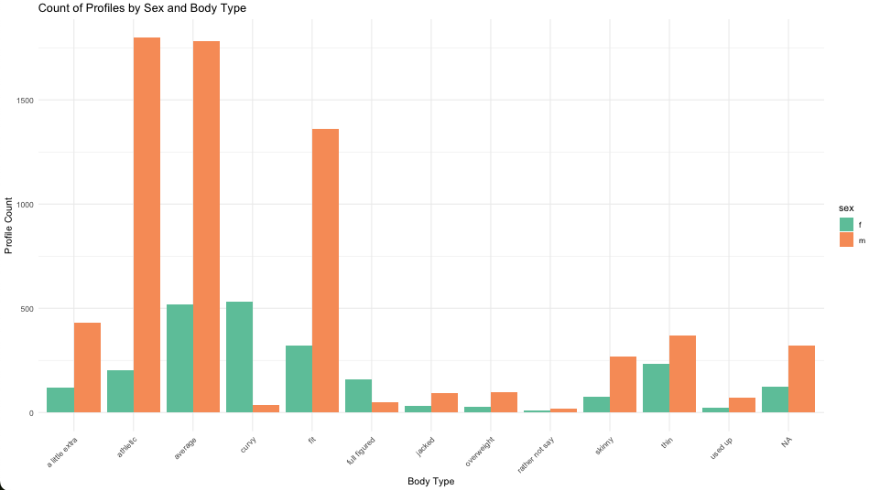
Persona#1 – Insights#1
Young Professionals
Top 3 most common male profiles are athletic, average or fit.
Top 3 most common female profiles are average, curvy and fit
Notes:
see slide and read out

Slide 11
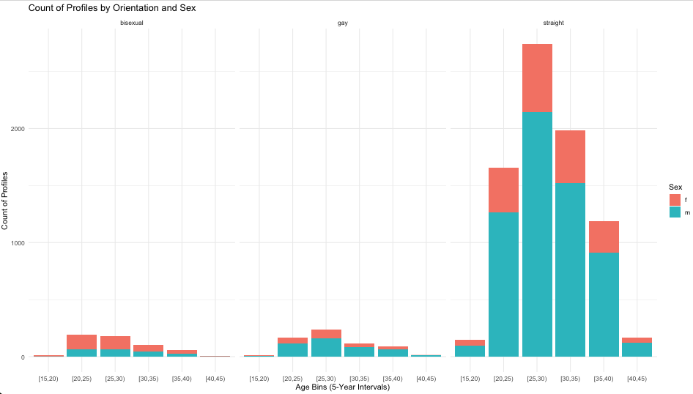
Young Professionals
Straight is the most frequently found orientation.
Profiles in the age groups 20-40 are most common, peaking between 25-40.
Amongst ‘Straight’ profiles, ratio of males to females is very high.
Necessary to plan actions to make sure straight male profiles believe they have a potential match.
Persona#1 – Insights#2
Notes:
see slide and read out

Slide 12
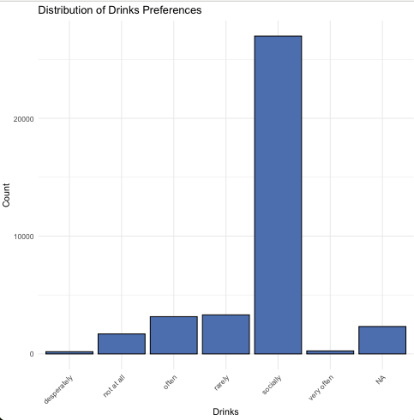
Free Spirits
Among the Free Spirits, most user profiles indicated interest in social drinking.
FREE SPIRITS are profiles with (single, no kid and no pet) with relatively less time commitments, by extension, marketing should target to profit for their “time” and/or “availability” for social events !
Persona#2 – Insights#1
Notes:
slide and read

Slide 13
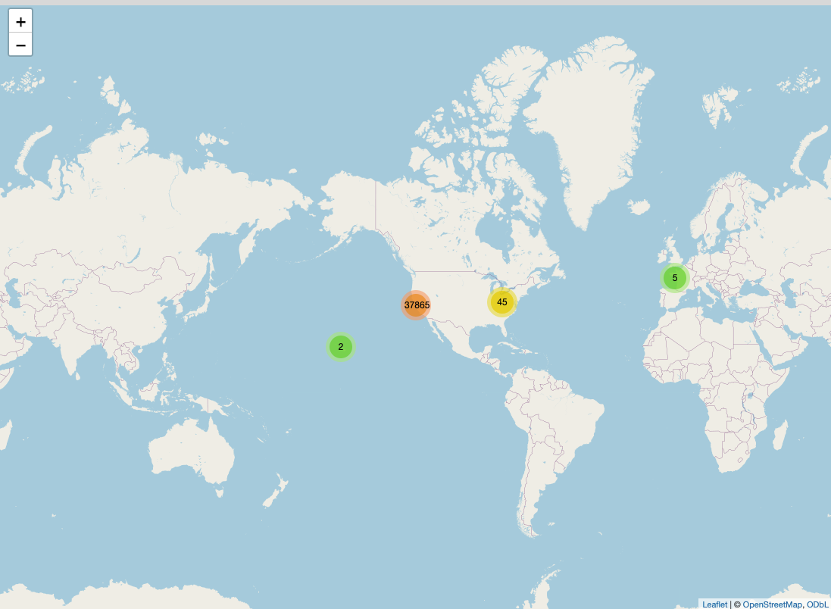
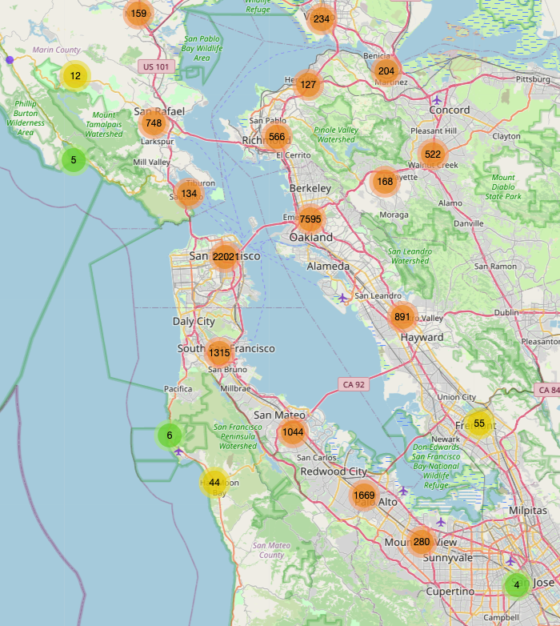
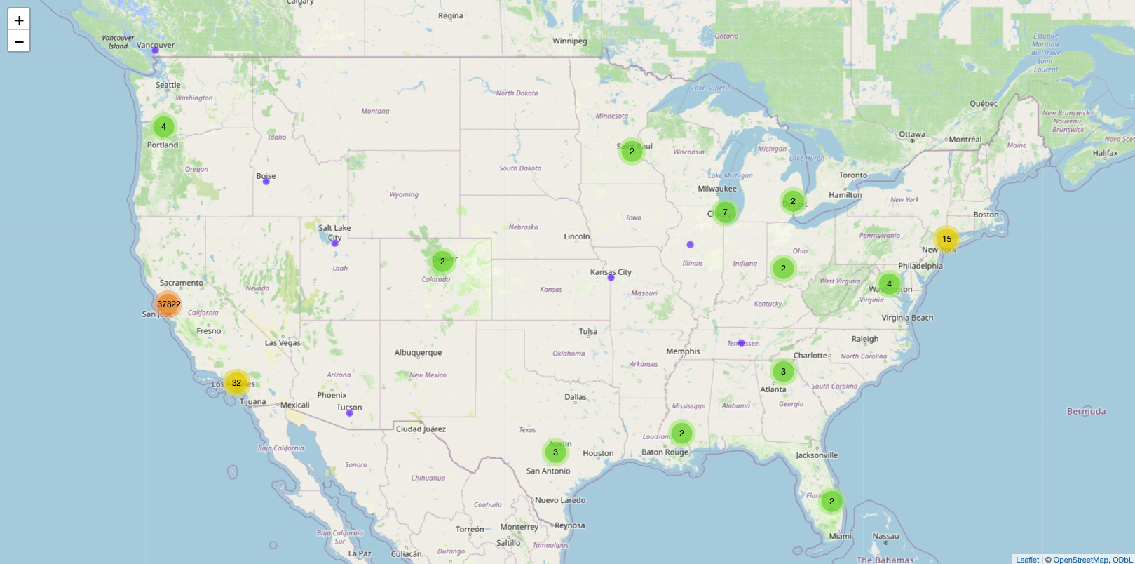
Free Spirits
On global map, overwhelming majority profiles in USA among all countries.
On USA Map, majority user profile concentration is on west coast
Zooming in to the SF bay area, we can further see hot spots of areas where user profiles are located.
Persona#2 – Insights#2
Notes:
see slide and read

Slide 14
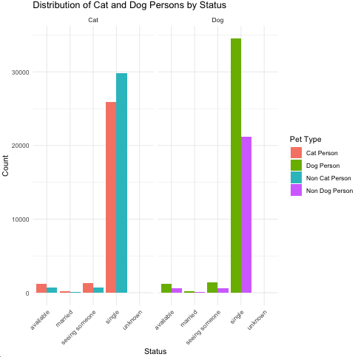
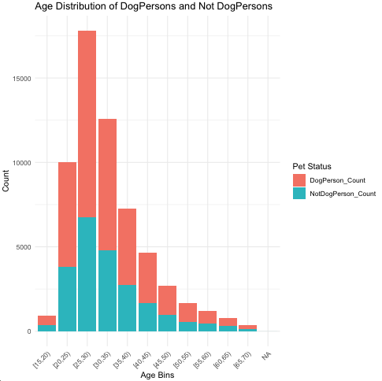
Pet Lovers
Among Pet Lovers, there are more user profiles who like/own a dog (than a cat)
There are more users who dislike a cat than there are users who like a cat
There are more users who like a dog than those who dislike a dog
Persona#4 – Insights
Notes:
see slide and read

Slide 15
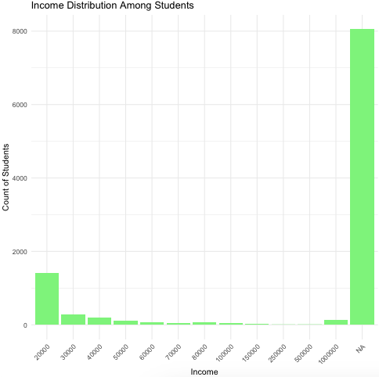
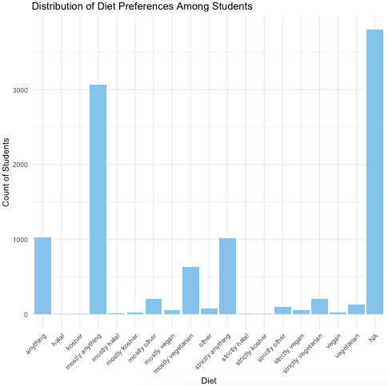
Students
Location | Count
Berkeley, CA | 1,368
Hayward, CA | 205
Oakland, CA | 1,226
San Francisco, CA | 4,361
Stanford, CA | 212
Most Students don’t have no income or low income.
Most Students don’t care about diet preferences.
Top 5 locations with student profiles.
Persona#3 – Insights
Notes:
see slide and read

Slide 16
Actionable Insights
From Data Visualizations

Slide 17
Takeaways & Strategy
Persona | % | Data Insights | Potential Strategies
Young Professionals | 15% | Most Male profiles are Fit, average and Athletic Most Female profiles are Curvy, average or Fit Ratio of Male / female profiles is skewed | Target ads for complimentary products/Services: For Men examples would be Protein shakes / athletic Sports Clubs For Women examples would be gym/Yoga/Spa discounts
Free spirits | 56% | Most of them like to drink socially users likely have Free time ; Several profiles geographically co-located. | Expansion of user Base OKC may Sponsor Local Events and offer promotions to sign up new members Incentivize referrals and new female signups for OKC User Retention OKC could offer a free drink for filling surveys to get further insights into customers opinions
Students | 17% | Don’t Care what they eat Don’t have much disposable income | Offer users discounts and mutually beneficial Loyalty programs at local fast-food restaurants (ex: offer Free nth meal for OKC user who eats at local fast-food chain)
Pet Lovers | 66% | More users who like / have dog than users who dislike dogs or have a preference about cats | Generate Ad-revenue by offering pet food subscription offers for OKC members
Notes:
read out potential strategies

Slide 18

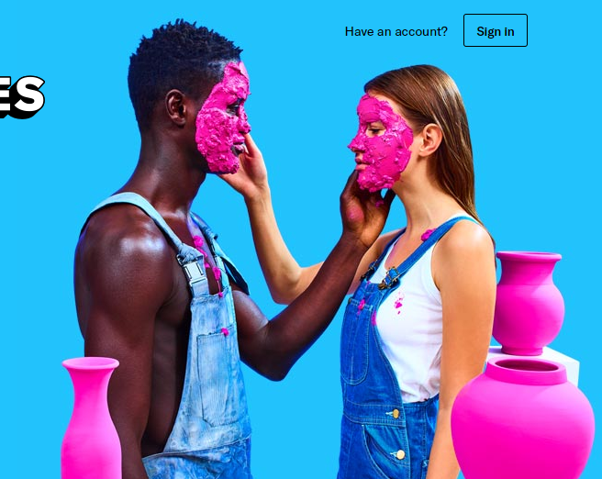
Thank you
Ohm Kundurthy
Click Here for Video Presentation
Click Here for R Code that supports data analysis & Visuals
Notes:
thank you for listening, happy to take any questions offline as this is a recording...

